Slide 1
Body detoxification is necessary to achieve optimal health

Slide 2
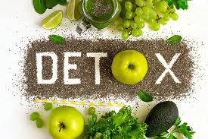
Detoxification is the key
The human body has many natural pathways to allow detoxification through liver, sweat, urine, faeces and more
But fast urbanization and exposure to pollutants, heavy metals, preservatives and pesticides has taken the average toxin consumption by human beings to an all-time high
Detoxification helps the body to get rid of toxins
https://food.ndtv.com/food-drinks/6-wonderful-health-benefits-of-detox-drinks-1664257

Slide 3
Detoxification Has Numerous Health Benefits
Helps in weight loss
Improves digestion
Improves liver function
Reduces inflammation
Improves skin
Boosts energy
https://food.ndtv.com/food-drinks/6-wonderful-health-benefits-of-detox-drinks-1664257

Slide 4
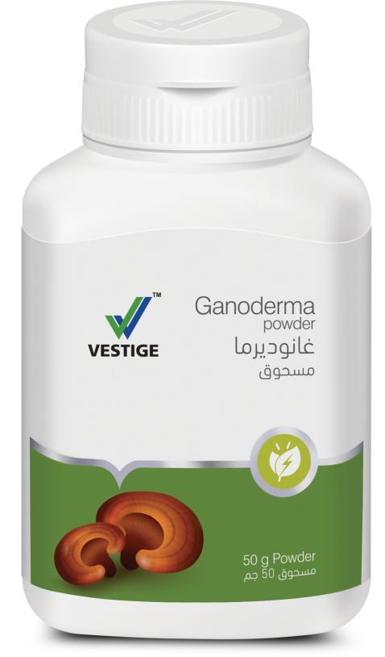
Vestige Ganoderma
Powder

Slide 5
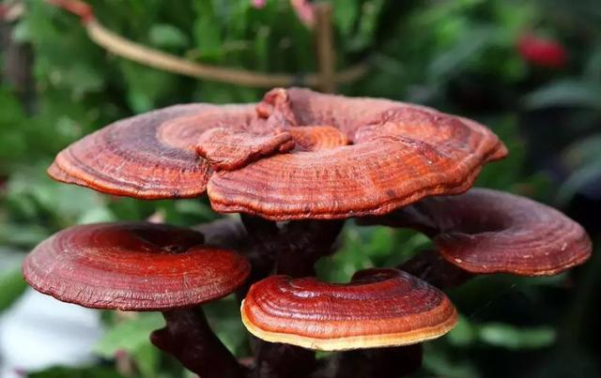
Ganoderma is a Wonder Herb
Ganoderma is a type of mushroom
This wonder herb is called the “King of the Herbs”
Ganoderma mushroom was earlier referred to as “Herb of Spiritual Potency” and the “Ten Thousand Year Mushroom”.

Slide 6
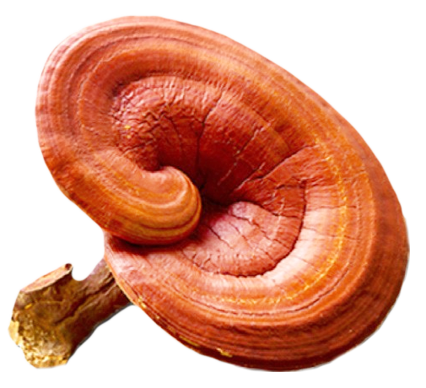
Ganoderma Usage Since Ancients Times
It has a documented history of over 200 years and is the most valued herb in traditional medicine
Wealthy people in ancient times used this wonder mushroom in the hope of obtaining immortality and calmness^
Ganoderma has an overall normalising effect on the body
Ganoderma scans, checks and detects body’s disorders
Ganoderma contains ≈400 nutrients
Boh et al., 2007; Cör et al., 2018

Slide 7
Ganoderma – Detoxify the body
Ganoderma eliminates the toxins accumulated in the body due to excess intake of medicines and junk food
Ganoderma promotes the efficient synthesis of bile and fatty acids, promoting faster detoxification of the chemicals from the body
http://www.ammmos.com/ganoderma_20_amazing_healt

Slide 8
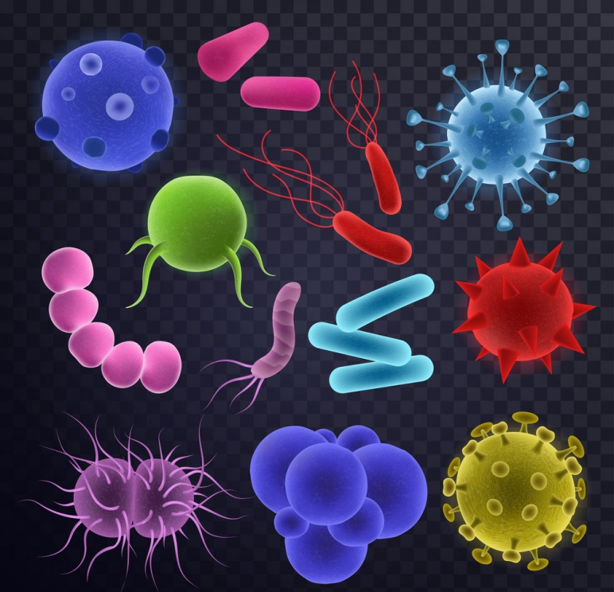
Ganoderma Is Helpful In Relieving Stress And Infections
Ganoderma inhibits oxidative stress-induced neuronal apoptosis, which may help in relieving stress
Ganoderma helps in reducing the chances of bacterial and viral infections

Slide 9
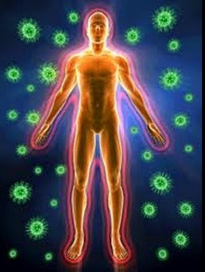
Ganoderma – Enhances Immunity
Ganoderma has immuno-stimulating activities by induction of cytokines & enhancement of immunological effect
Different components from Ganoderma were proved to enhance the proliferation and maturation of T and B lymphocytes, splenic mononuclear cells, NK cells, and dendritic cells
Enhance both adaptive and innate immunities
https://www.ncbi.nlm.nih.gov/books/NBK92757/

Slide 10
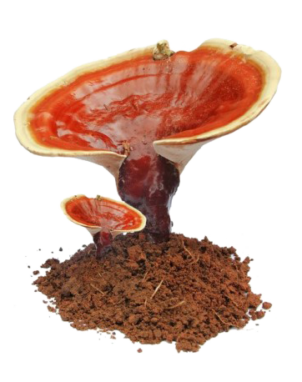
Ganoderma – An Antioxidant
Polysaccharides and Triterpenoids in Ganoderma , show antioxidant activity
Antioxidants in Ganoderma were found to be absorbed quickly after ingestion, resulting in an increase in the plasma total antioxidant activity
Polysaccharides were also reported to protect the immune cells from oxidative damage
https://www.ncbi.nlm.nih.gov/books/NBK92757/

Slide 11
Ganoderma & Hepato-protective action
Ganoderma has hepato-protective effect on the liver
Ganoderma also helps in ulcer healing

Slide 12
Vestige Ganoderma - Dose
Suggested usage
2g powder dissolved in water per day

Slide 13
