Slide 2
GRAVITY
VESTIGE

Slide 3
VESTIGE

Slide 4
VESTIGE

Slide 5
VESTIGE

Slide 6
VESTIGE

Slide 7
VESTIGE

Slide 8
VESTIGE

Slide 9
VESTIGE

Slide 10
VESTIGE

Slide 11
VESTIGE

Slide 12
VESTIGE

Slide 13
VESTIGE

Slide 14
VESTIGE

Slide 16
VESTIGE

Slide 17
VESTIGE

Slide 20
56
2,00,00,000
180 +
VESTIGE

Slide 21
2750
Yr 20-2021

Slide 22
TOP 36
IN THE WORLD
VESTIGE

Slide 23
VESTIGE

Slide 28
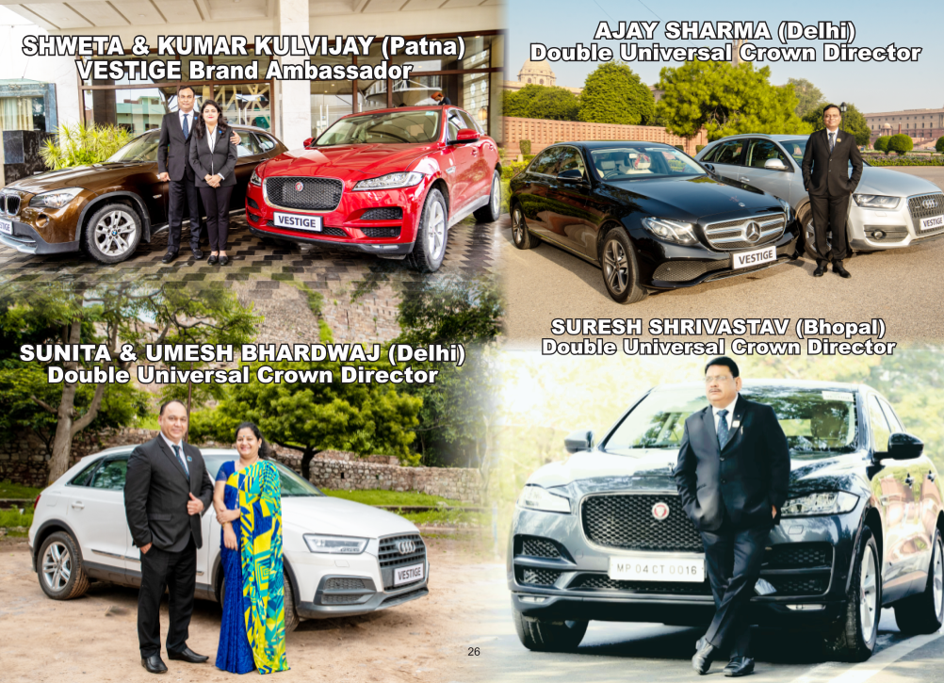

Slide 29
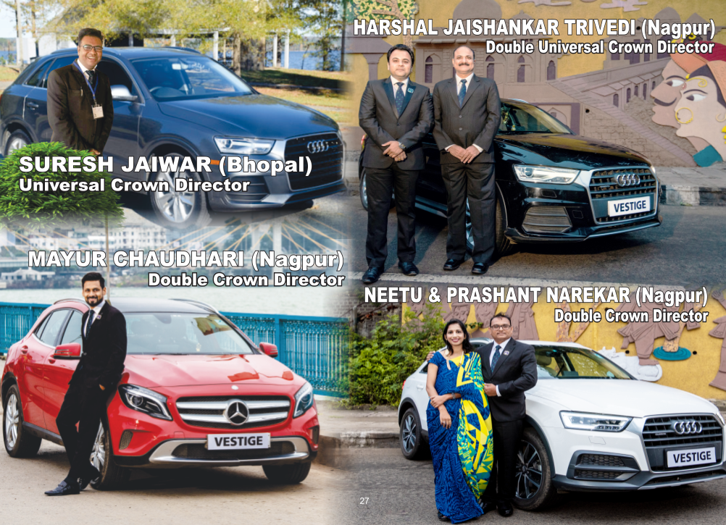

Slide 30
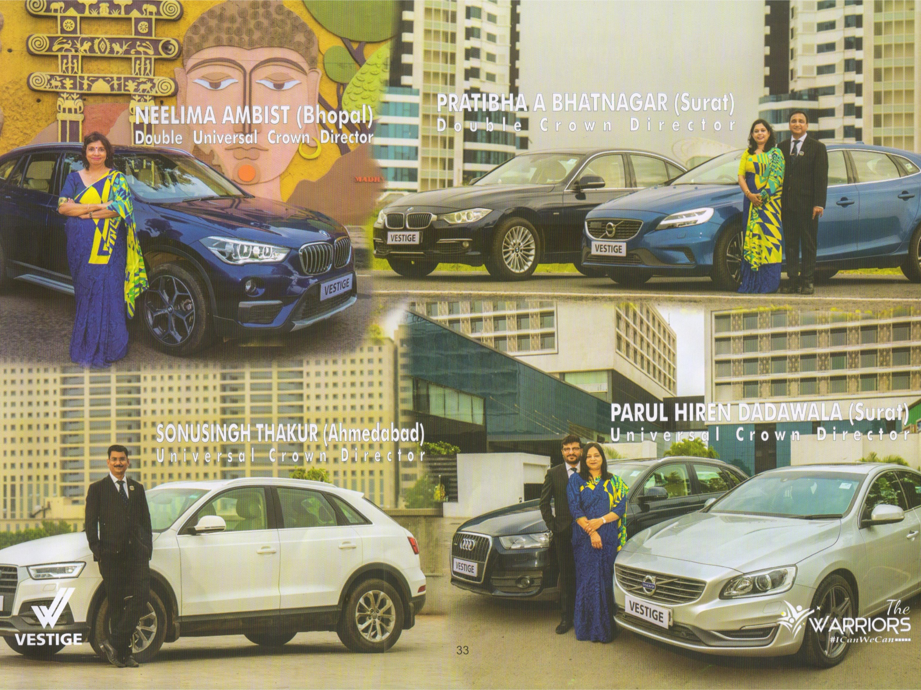

Slide 31
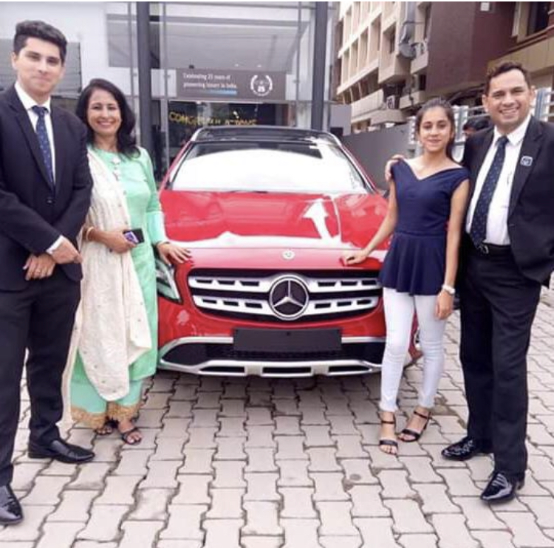
VIPIN & POONAM SHARMA (DEHRADUN)
Double Crown Director

Slide 32
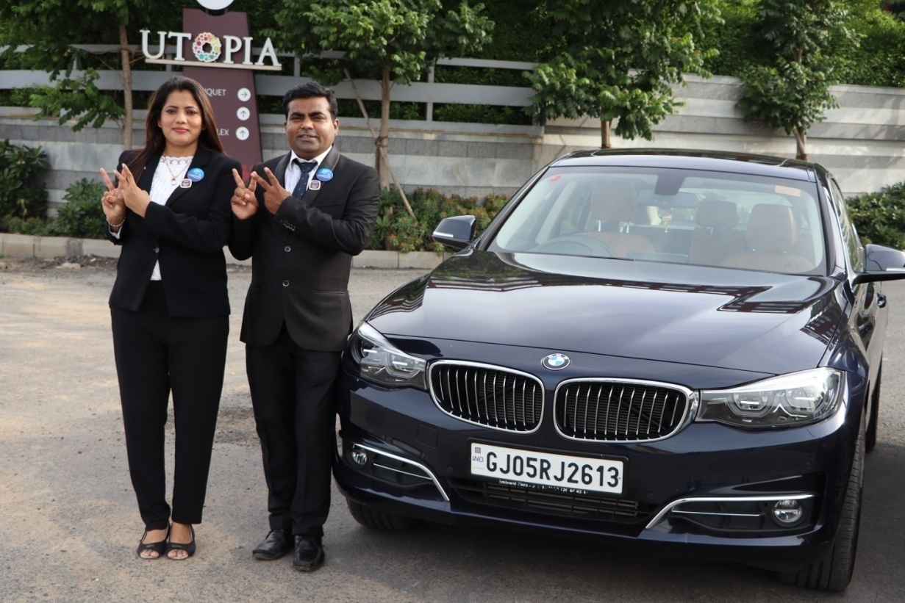
JIGNESH & POOJA KHENGAR (UCD)

Slide 34
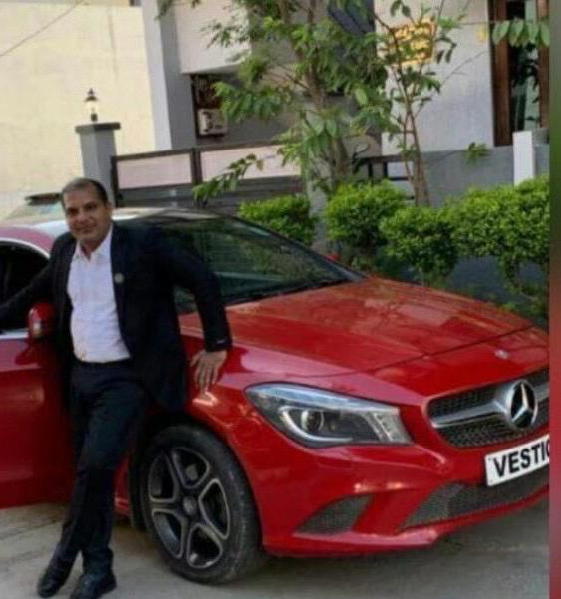
BHUSHAN MAURYA (MUMBAI)
Crown Director.

Slide 36
VESTIGE

Slide 37
VESTIGE

Slide 39
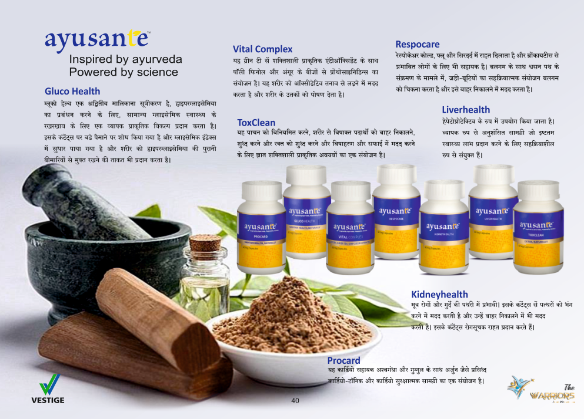

Slide 40
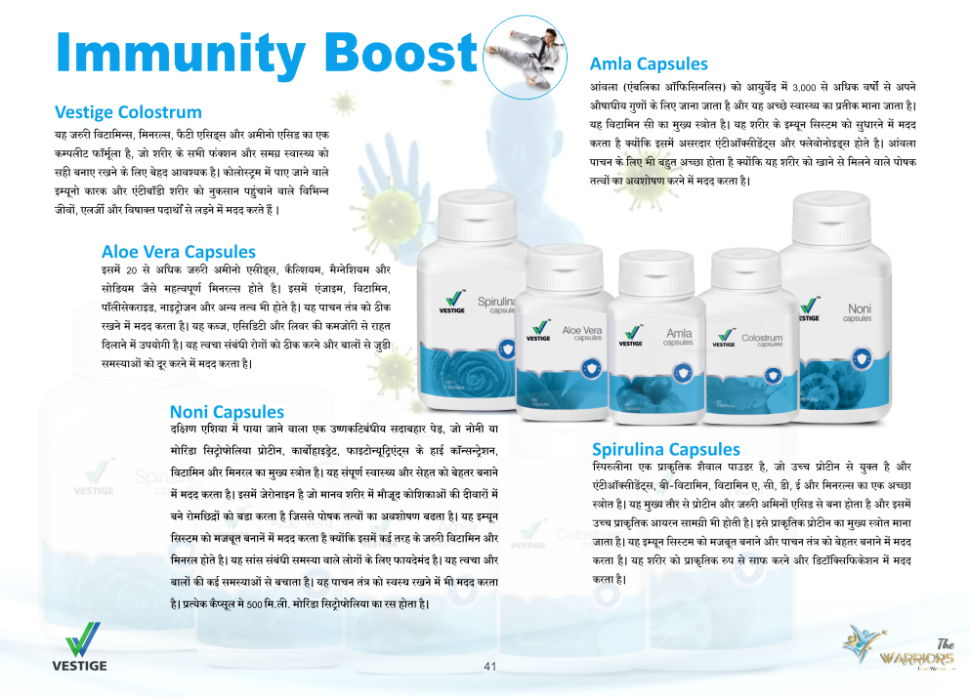

Slide 46
VESTIGE

Slide 49
VESTIGE

Slide 52
VESTIGE

Slide 53
VESTIGE

Slide 54
VESTIGE

Slide 55
VESTIGE

Slide 58
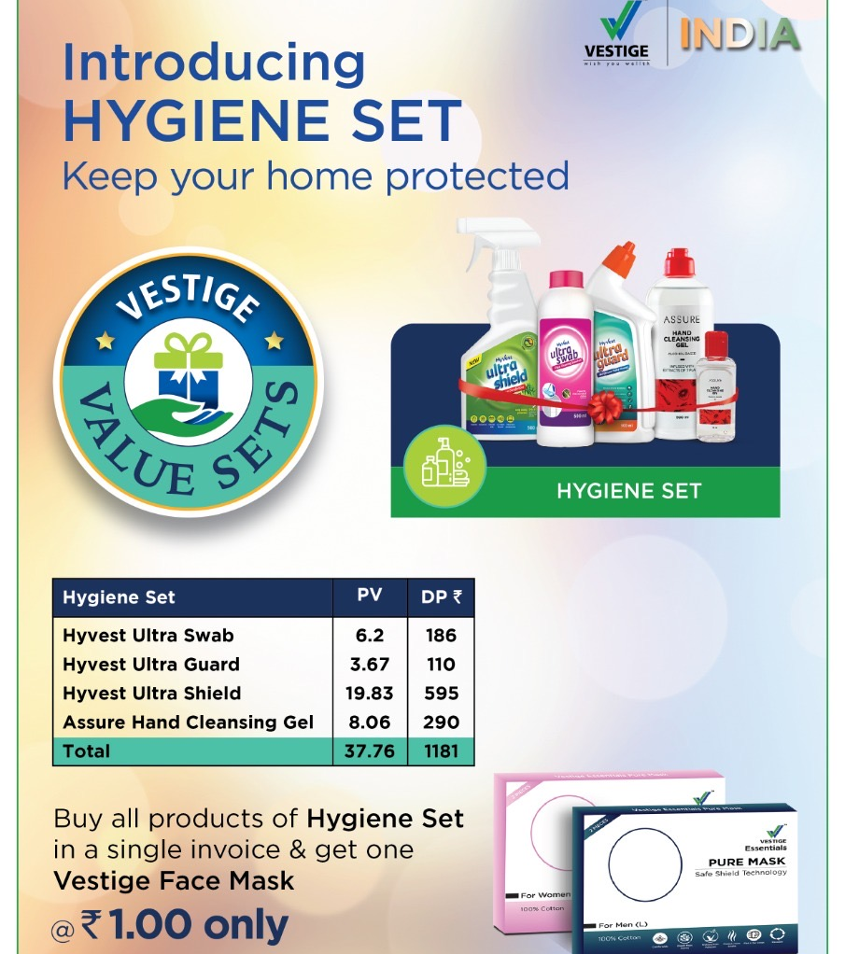

Slide 59
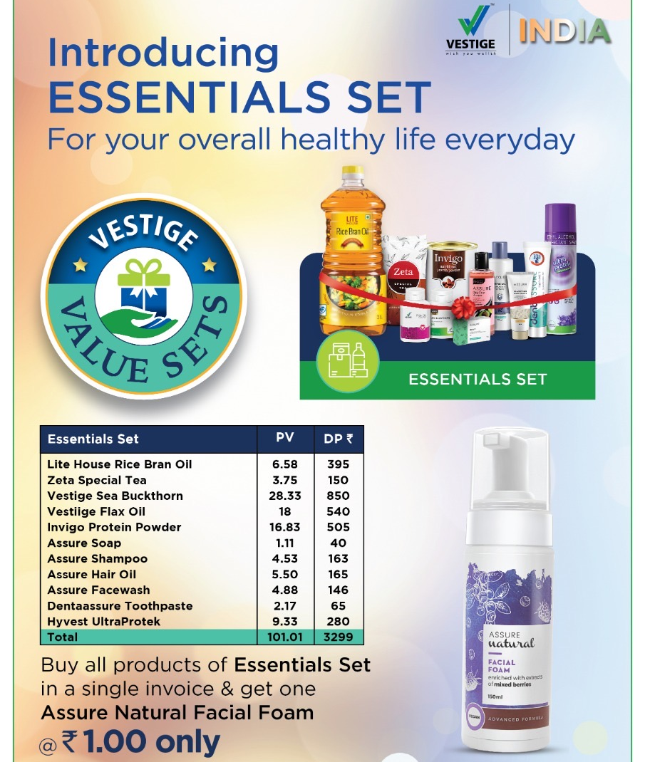

Slide 61
ATMANIRBHAR SUCCESS PLAN
10
10. टीम बिल्डिंग बोनस. : 2%

Slide 62
VESTIGE

Slide 65
4. TEAM BUILDING BONUS - 2%
VESTIGE

Slide 66
5.

Slide 67
6. LEADERSHIP OVERRIDING BONUS - 16%
VESTIGE

Slide 68
7. TRAVEL FUND - 3%
VESTIGE

Slide 69
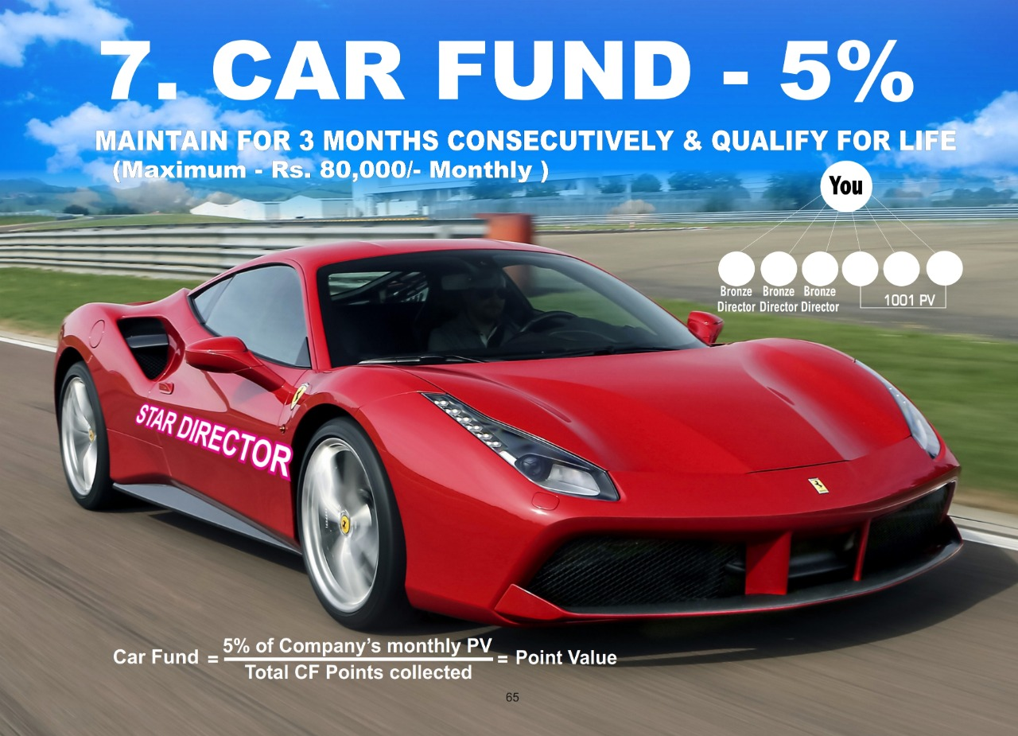
8.

Slide 70
9.

Slide 71
10.
VESTIGE

Slide 72
VESTIGE

Slide 73
VESTIGE

Slide 74
CONSISTENCY ADVANTAGE

Slide 78
VESTIGE

Slide 81
VESTIGE

