Slide 1
ESSENTIALS SET

Slide 2
SEA BUCKTHORN

Slide 3
SEA BUCKTHORN
Over 190 bioactive compounds in one tiny berry
Carotenoids
Tocopherols
Flavonoids
Lipids
Ascorbic acid

Slide 4
SEA BUCKTHORN BENEFITS
Maintains high energy
Vitamin C and other nutrients helps to reduce headache, dizziness and increases mental attention
Wonderful Antioxidants to protect brain tissues from damaging effect of free radicals and toxins
Stamina building:
Vitamins help to reduce common symptoms like fatigue such as low energy and muscle tension and help in getting a sound sleep.
Cardiac benefits
Flavonoids may help to regulate blood pressure, improve heart function and reduce stress on heart tissue.
Skin benefits
Vitamin A, Vitamin E and Omega 7 fatty acids are considered essential nutrients for skin and they promote tissue and collagen regeneration, reduce skin wrinkles and premature skin ageing

Slide 5
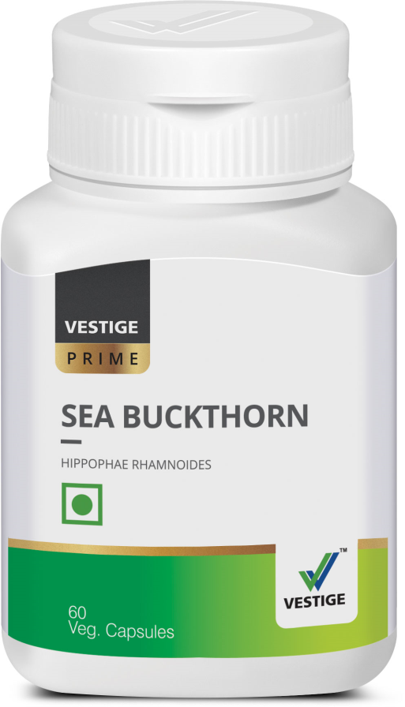
DOSAGE
One capsule twice a day after meals

Slide 6
FLAX OIL

Slide 7
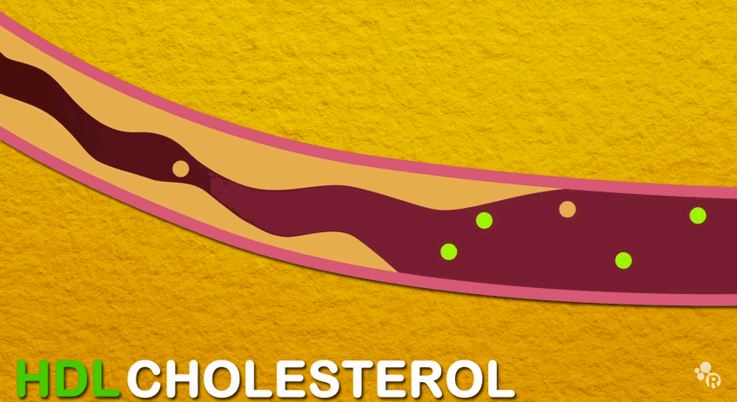
FLAXSEED OIL BENEFITS
Helps lower cholesterol & triglycerides
Prevents blockage of arteries
Helps prevent accumulation of fatty deposits inside blood vessels
Play a role in burning body fat
Aid in the growth of healthy hair and nails
Promote healthy skin
It helps to balance hormonal levels in women
It helps to regulate the menstrual cycle

Slide 8
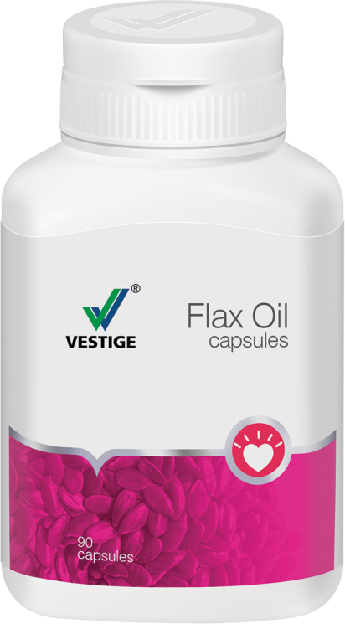
DOSAGE
Two to three capsules a day after meals

Slide 9
INVIGO PROTEIN POWDER

Slide 10
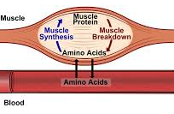
NEED OF PROTEIN
A vital source of nourishment for the body
Made up of amino acids that form the building blocks for the body’s growth
Plays a major role in development of cells and fluids in the body
Vital for the Growth + Repair + Maintenance of the body
Because of busy and stressful lifestyles, the body does not get enough protein in the diet
Protein Requirement= 1gm/kg IBW

Slide 11
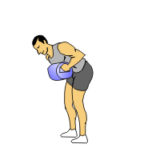
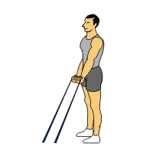
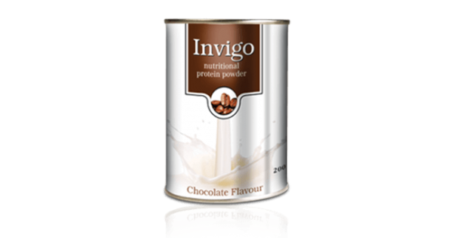
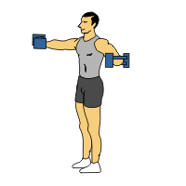
PROTEIN POWDER
A nutritional protein powder that is ideal for the entire family
Rich chocolate taste.
Low in fat & high in protein
Easy to digest

Slide 12
DOSAGE
One to two scoops daily with water or milk.

Slide 13
RICE BRAN OIL

Slide 14
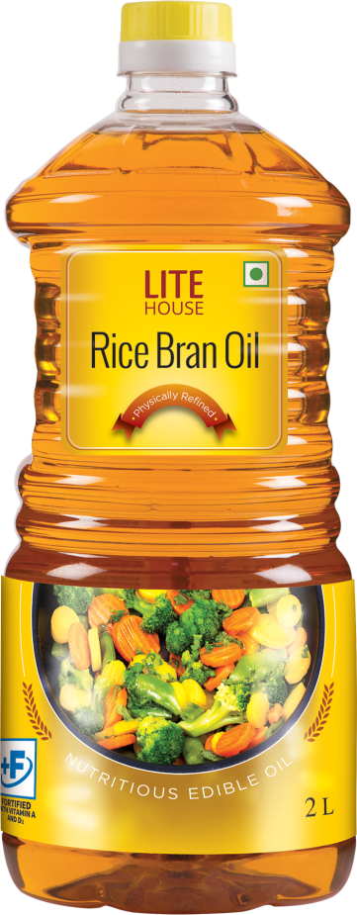
RICE BRAN OIL
The most balanced and versatile oil, closest to recommendations of-
WHO (World Health Organization)
NIN (National Institute Of Nutrition)
AHA (American Heart Association)
Helps manage health of the heart due to the presence oryzanol
Nutritionally superior compared to other cooking oils
Rich in antioxidants
Economical – 15% less absorption of oil during frying
It has a light and neutral flavour, compatible with both, low heat & high heat cooking
Rice Bran Oil is truly "The Healthiest" edible oil, containing antioxidants, nutrients and good fats

Slide 15
VESTIGE ZETA SPECIAL TEA

Slide 16
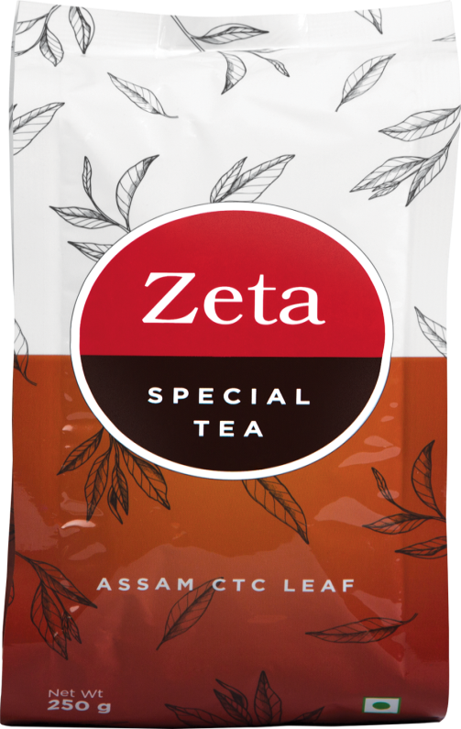
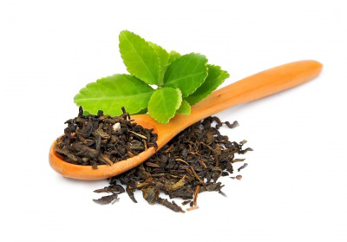
ZETA SPECIAL TEA
VESTIGE ZETA SPECIAL TEA
• Exquisite blend of pure Assam and long leaf tea
• Rich in antioxidants
• Helps to protect the cells and tissues in the body

Slide 17
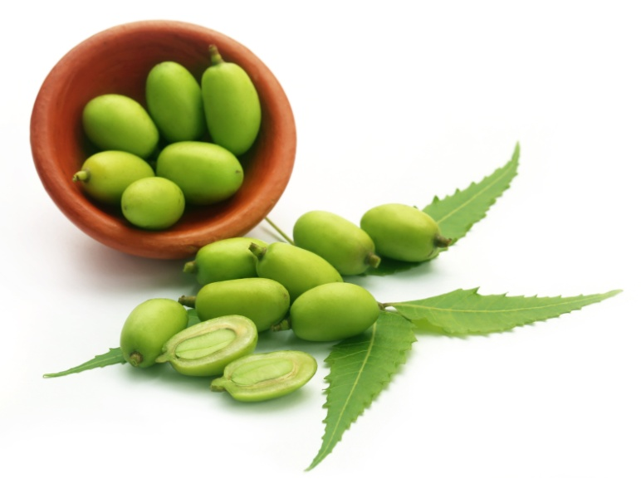
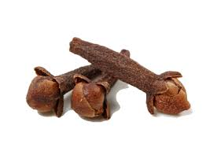
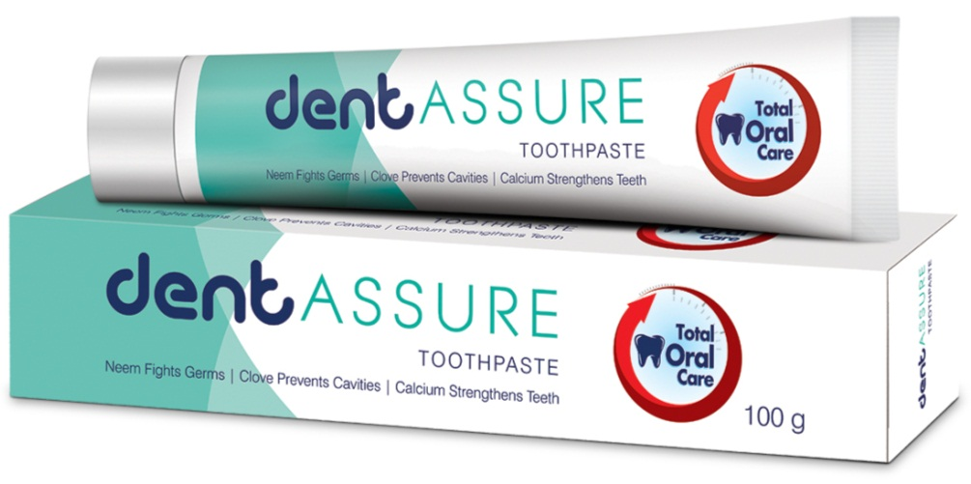
DENTAASSURE TOOTHPASTE
Dentaassure Toothpaste is a foaming paste with fluoride, for daily use
It is a unique formula with dual protection of Neem and Clove that fights germs and prevents dental cavities
It also helps support gum health
It contains calcium that strengthens the teeth
Neem fights germs
Clove prevents cavities and supports gum health

Slide 18
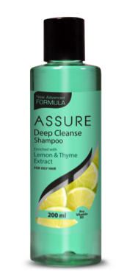
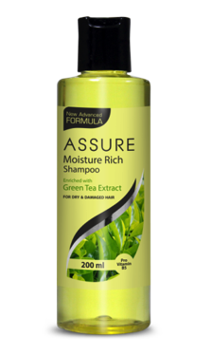
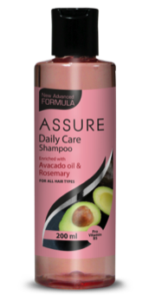
ASSURE SHAMPOO
Assure Deep Cleanse
Shampoo
(For Oily Hair)
Assure Moisture Rich
Shampoo
(For Dry + Damaged Hair)
Assure Daily Care
Shampoo
(For all Hair Types)
Helps reduce excess oil and control sebum secretion thus encouraging healthy hair growth
A special herbal complex with lemon and thyme extracts nourishes the hair while adding body and sheen
Enriched with green tea extracts, which refreshes the hair and scalp, restores dry hair and repairs split-ends
Milk protein moisturizes and conditions the hair without weighing it down
Helps maintain the moisture balance in the hair and scalp
It adds extra bounce to the hair leaving it glossy smooth and healthy

Slide 19
ASSURE PRODUCTS

Slide 20
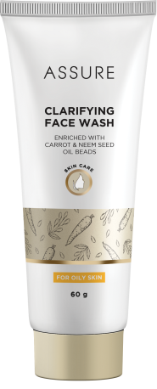
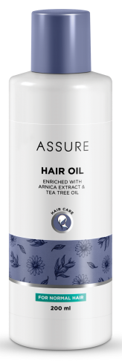
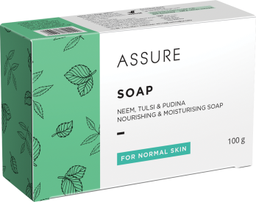
ASSURE PRODUCTS
Assure Nourishing & Moisturizing Soap
Assure Clarifying Face Wash
Assure Hand Was
Assure Hair Oil
Unique blend of Neem, Tulsi and Pudina.
Cleanses, disinfects and refreshes skin
• Helps clear skin and prevents blemishes
• Includes innovative moisturizing beads
• Cleanses and nourishes the skin
• Special blend of Arnica and tea tree oil
• Helps prevent hair loss
• Adds sheen and prevents dandruff

Slide 21
HYVEST ULTRA PROTEK

Slide 22
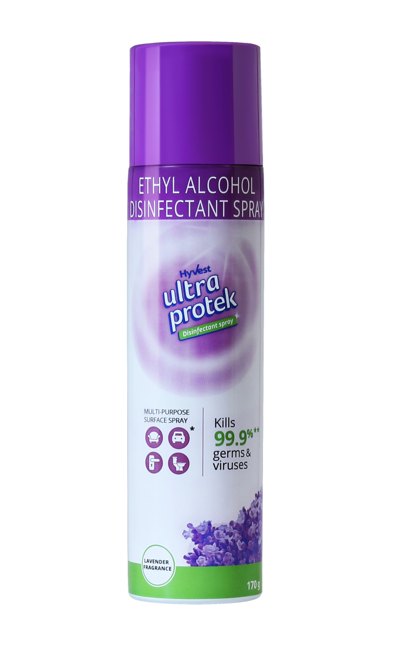
HYVEST ULTRA PROTEK
Hyvest Ultra Protek is a 70% w/w alcohol, anti-bacterial disinfectant spray, designed to inactivate or destroy microorganisms from both soft and hard surfaces.
Disinfect high-traffic surfaces such as tables, door knobs, chairs, keys and packages with a single easy spray, leaving behind an earthy floral fragrance after use.
Also suitable for other surfaces such as kitchen sink, dustbin, chairs, sofas, shower taps and other bathroom surfaces, mattresses, car seats, curtains and carpets.

Slide 23
ESSENTIAL KIT
Essential kit contains all the products required in our day to day life.
It is a combination of supplements, body care, health care and home care products, health food.
Powerful kit to provide all the necessary day to day products in one go.
A chance to try and experience different categories of products and boost our business.
Different people different need and this kit complete all our requirements.
Combination of best and most trusted products from all the catgories.

Slide 24
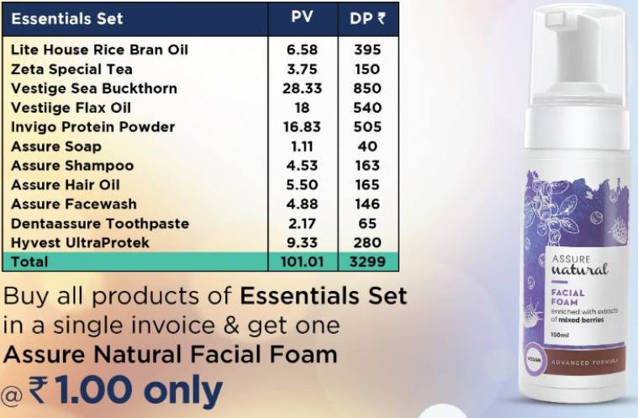
ESSENTIAL KIT

Slide 25
THANK YOU

